Slide 1
Presenting and Demonstrating FeatureCAM

Slide 2
Note to Presenter
(This is a hidden slide)
This master copy of this presentation comes from our readily available FeatureCAM training materials.
You can download the most current version from http://distrib.featurecam.com.
If you have suggestions for enhancement to this presentation, please send them to support@featurecam.com, and please give the name of the PPT.

Slide 3
Points We’ll Cover
FeatureCAM’s history
Typical customer profiles
Why customers buy FeatureCAM
Sales approaches
FeatureCAM’s technology difference
Regions of the world where FeatureCAM is strong
Demonstration outline
Competitive Products

Slide 4
FeatureCAM History
FeatureCAM has been sold since 1995 with major upgrades annually
Original technology heavily influenced from relationships with Universities
It is a mature product currently in its 13th release
FeatureCAM has been sold to more than 4,000 customers world-wide
Merged with Delcam in 2005

Slide 5
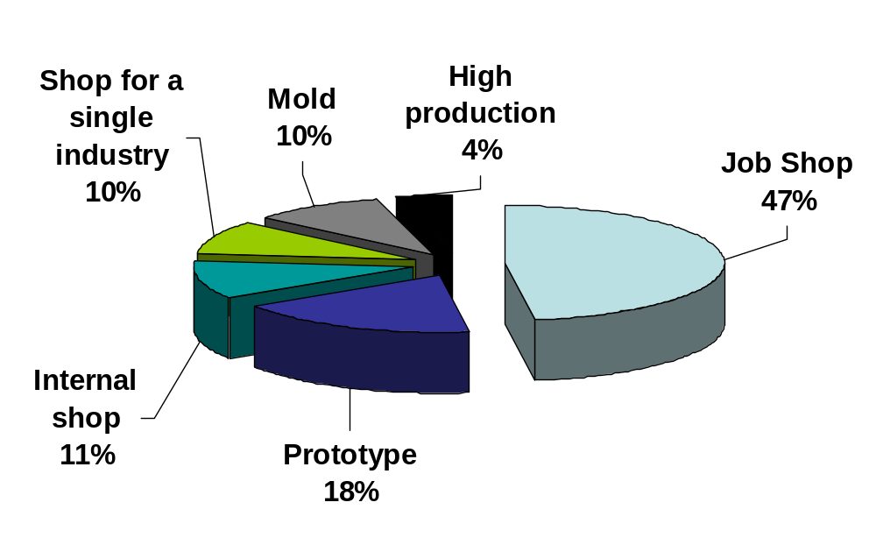
Job Shops Main Customers

Slide 6
Typical FeatureCAM Customer
Customer who focuses on milling, but wants a broad solution with common user interface
Customer who embraces new technology
Customer with high turnover (training needs)
Customer who use their CAM occasionally (simplicity of use)

Slide 7
Reasons for Purchasing
Ease of Use
Completeness of solution
Integrated product line
Relationship with salesman
Price
Reputation

Slide 8
Feature-Based Benefits
Ease-of-Use
Speed
Consistency

Slide 9
Ease of Use
  After you import or draw the part and identify the features,
  FeatureCAM automatically…
  • selects tools
  • selects speeds/feeds
  • determines roughing and finishing operations
  • generates toolpaths
  • creates NC code
  FeatureCAM also gives you the control to customize your part programs to meet your specific needs. Traditional CAM packages force you to tediously enter all these details one by one.

Slide 10
Speed
Traditional CAM
  You draw the geometry
  You select an operation
  You select the geometry
  You define the cut depth
  You define the rough tool
  You define the depth/pass
  You define the stepover
  You select an operation
  You select the geometry
  You define the finish tool
  You define the depth/pass
  You define the stepover
FeatureCAM
  You draw the geometry
  You select a feature
  You select the geometry
  You define the cut depth
  FeatureCAM selects the rough tool
  FeatureCAM defines the depth/pass
  FeatureCAM defines the stepover
  FeatureCAM selects an operation
  FeatureCAM selects the geometry
  FeatureCAM selects the finish tool
  FeatureCAM defines the depth/pass
  FeatureCAM defines the stepover

Slide 11
Consistency
Get same results every time
Easy UI requires less input
Get fewer mistakes with NC code in less time
Yet you have control to make needed changes and customize the part to meet specific needs
FeatureCAM includes
  Import from most major CAD systems
  dwg, dxf, iges, a1, scl, x_t, x_b, sat, sab, sldprt, catia, step & inventor
  Material library
  Tooling library
  All of our post processors and the ability to modify/create your own

Slide 12
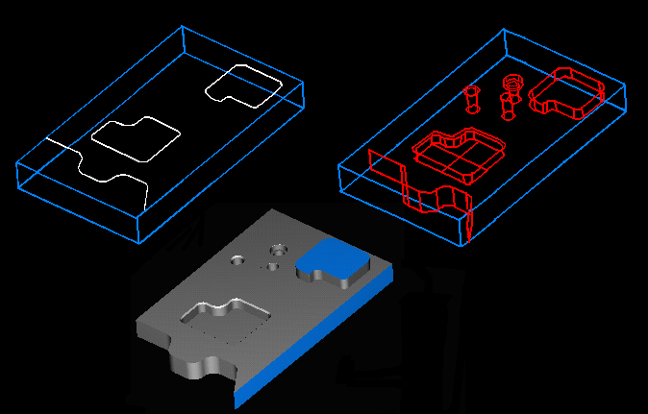
What is Feature-based?
Instead of programming parts one operation at a time, FeatureCAM defines parts with features – a hole, slot, pocket, boss, face, side, surface, etc.
Curves
Features
Toolpaths

Slide 13
Differences With PowerMILL
NC code is much more important in an FC demo
Material removal simulation is the primary visualization tool
Often you must show entire product range
FeatureCAM sales cycle will be shorter than PowerMILL’s
You may be expected to program a part on-the-spot (US FeatureCAM salespeople are capable of this and do it regularly)

Slide 14
Sales Approaches
Start with base products and upgrade to 3D and the rest of the product line over time
Sell to first time CAM users based on simplicity of interface and automation of details
Sell to experienced users based on automation and broadness of solution

Slide 15
The First Meeting
Lead conversation toward FeatureCAM’s strengths, like AFR from solids
Most customers don’t understand feature-based concept right away, so make sure they understand it and why it makes FeatureCAM different
Take control of the meeting with your own demo, before allowing customer direct the meeting
Know what makes FeatureCAM easy-to-use

Slide 16
Demo Principles
Keep it simple – simple screen layout, simple part, clarify basic concepts
Use your own part
Create NC code within 5 minutes
Your goal is to sell the prospect on how different and easy to use FeatureCAM
Remember to sell, not train
Make the claim that FC is the easiest system to use and learn in the world
Constantly seek to demonstrate things that point out the feature-based difference
Do brief overview of program process, then go back

Slide 17
Production Shop Demo Outline
Show brief 2.5D part
  Introduce feature-based approach and simple user interface
Demonstrate FeatureRECOGNITION
  Show how features can be automatically created from solid models
Demonstrate Turn, Wire or 3D to show breadth of product line

Slide 18
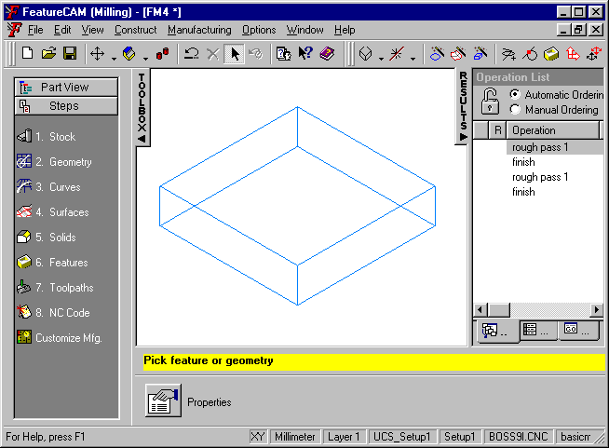
Step 1 – Layout and Stock
Keep the screen layout simple
  Remove extra toolbars
Use the STEPS buttons to show how simple the system is to use
Briefly introduce them to the stock by showing them the dimensions and material types

Slide 19
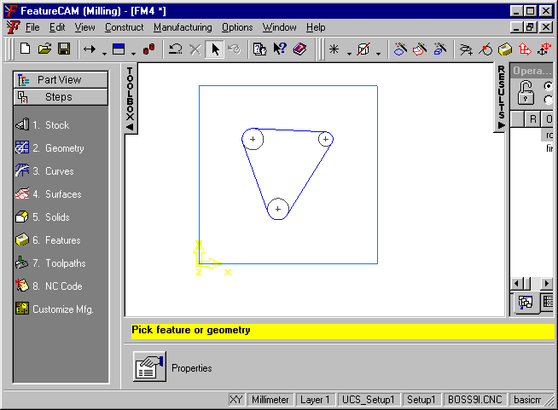
Steps 2 & 3 – Geometry and Curves
Explain how quick and easy it is to sketch
Point out the automatic snapping
All geometry tools are located under the Geometry step

Slide 20
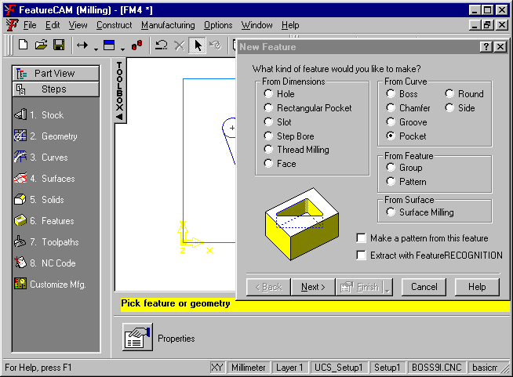
Step 6 - Features
Create a pocket
Explain that the names listed in the New Feature dialog box are our feature types
Quickly enter dimensions and hit Finish
Don’t walk through the entire wizard

Slide 21
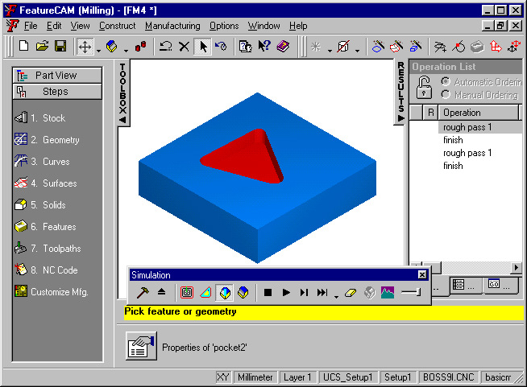
Step 7 – Toolpaths
Click the 3D simulation button
Show all the things FeatureCAM just did automatically
  Select tools
  Calculate feeds/speeds
  Calculate stepover, cut depth
  …

Slide 22
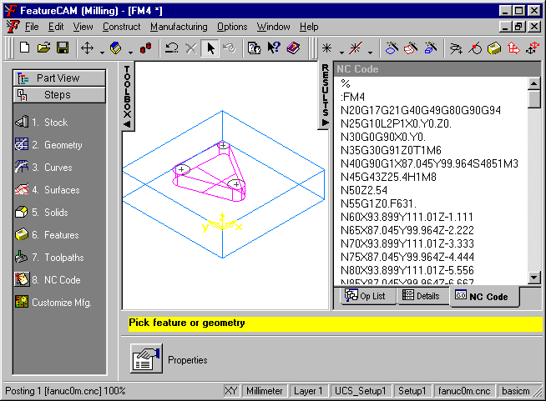
Step 8 – NC Code
Click the NC Code Step and create code.
Explain that all we had to do to reach this point is to sketch a curve or

Slide 23
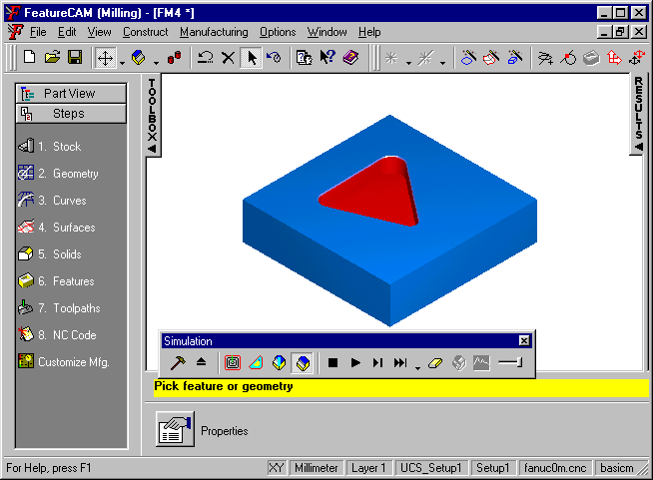
Make Changes
Make changes and show how FeatureCAM reacts to them
Change the radius of a circle and show that:
  The feature updates
  Different tools are selected
  Different cut depths are calculated

Slide 24
Summarize
Summarize what he’s seen
  You’ve seen how the Steps of FeatureCAM make the system very easy to learn
  You’ve learned how the feature-based allows you to make programs faster than any other system
  You’ve seen how to use features to program a part from a drawing

Slide 25
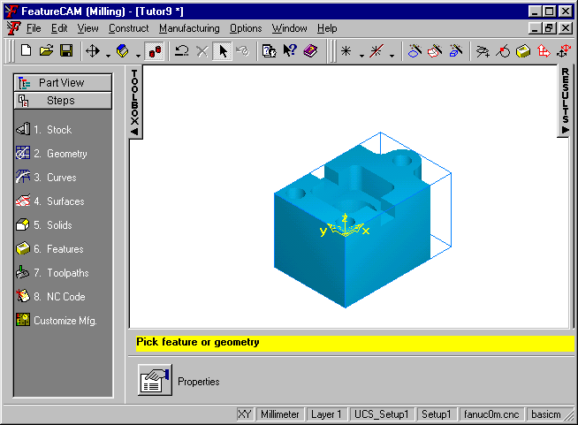
FeatureRECOGNITION
Read in tutor9.sat
Explain that this part looks like a collection of holes and pockets
FeatureCAM can extract this data directly without your having to enter any dimensions

Slide 26
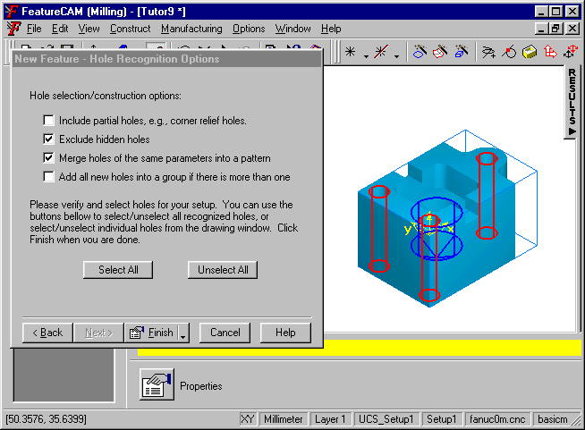
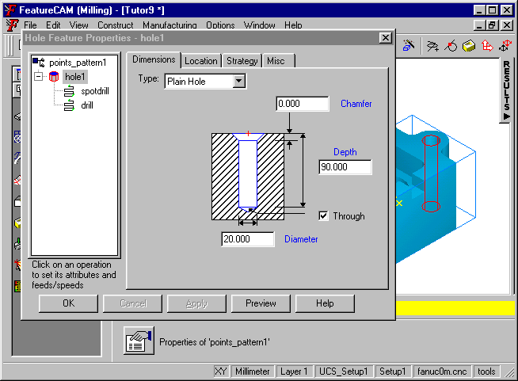
Holes
Automatically recognize the holes
  Ignore the pocket in the middle
Show them that FeatureRECOGNITION automatically found all the holes and the hole dimensions

Slide 27
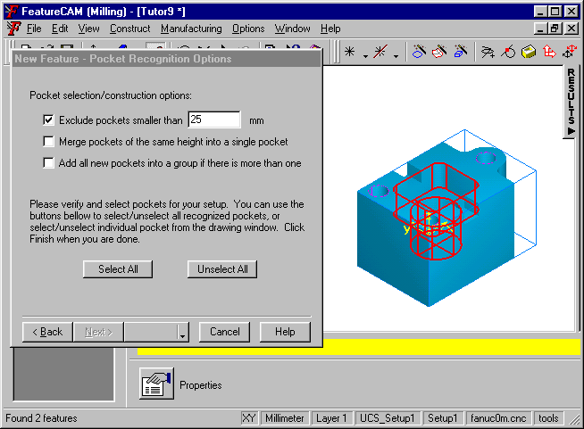
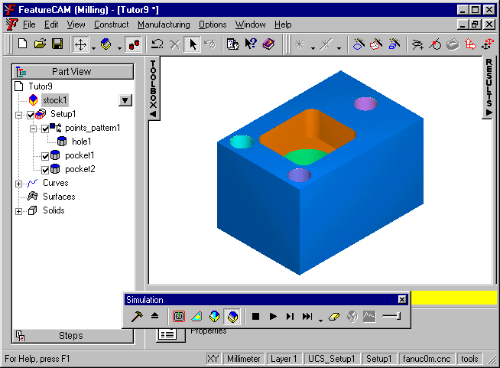
Pockets
Automatically recognize the pockets
Show that the pockets are automatically recognized
Simulate toolpaths

Slide 28
FeatureRECOGNITION Demo Tips
Practice IFR before offering to do customer parts
  IFR is more of an art than a science
  Get parts ahead of time and work with Delcam USA to perfect your skills
Surface models are not as automatic as solid models
  Don’t expect them to be as fast as simple solid examples

Slide 29
Summary
FeatureRECOGNITION automatically recognizes features from surface and solid models from CAD systems
Once the features are recognized, the automation of FeatureCAM takes over

Slide 30
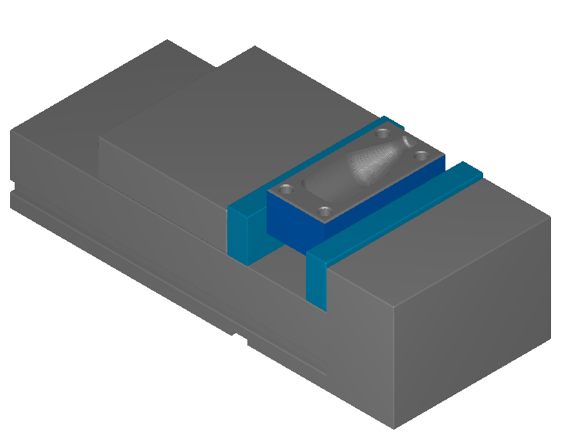
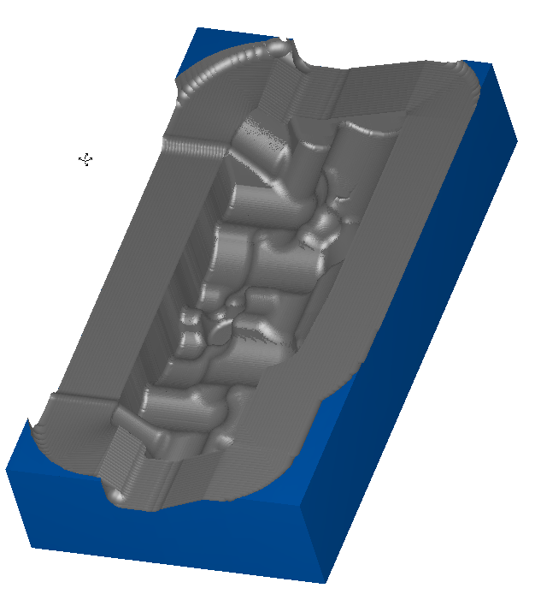
FeatureMILL3D
Novice 3D user :
  Start with a simple part like botmold.fm and show them how easy it is to make toolpaths from scratch.
  Show them the surface and solid wizard. New users like the graphical nature of this interface.
Experienced user:
  Prepare a more complicated part with toolpaths already calculated.

Slide 31
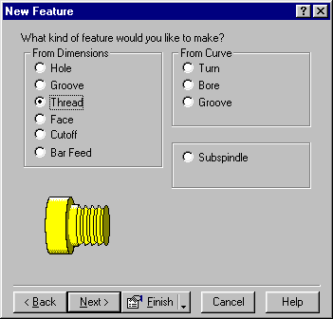
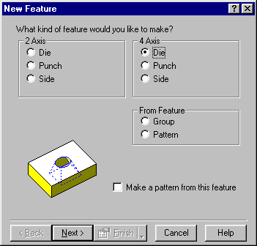
Other Applications
Show turn or wire
All drawing tools, UI, sim, posting are the same
The major difference are the feature sets to support each application

Slide 32
Online Demos
Consider low-cost online demonstrations
Webex is an excellent tool for initial remote demos if internet connectivity is good
Can show initial benefits and help customer with evaluations

Slide 33
Video Demos
Some dealers use video-based demonstrations of customer files when a demo is difficult to give in person

Slide 34
Competition
(We are always seeking feedback from sales partners regarding competition)

Slide 35
Mastercam
They dominate mid-range cam
No real features, feature recognition or automation
Old fashion interface – still not windows based even after Mastercam X
Much more difficult to use
Does not have turn/mill or multi-turret
Has five axis simultaneous
Will generally charge for posts
Has a lower-price entry-level 2D
Network installations are difficult
“it will be easier to recruit for my mastercam” can be countered with FeatureCAM’s ease-of-use
They compete based on market share – they are the “safe” option – but we have a better product
Notes:
Mastercam sells in japan twice as much software as combined featurecam and powersolution sales! These are the people to beat.

Slide 36
GibbsCAM
Marketing message is on ease of use, not so much on automation
uses an interactive operations-base approach
Makes it easy for the customer to make decsions
Our feature-based approach is much easier to learn
Feature recognition is brand new and licensed from GSSL (like everyone else)
Still has a Mac look
Equivalent product breadth to FeatureCAM
Gibbs has more experience on advanced turning
Gibbs has weak global distribution
Cumbersome drawing interface
Head to head we always win

Slide 37
EdgeCAM
They have good CAD interfaces and good fixture/machine models
  Our CAD interfaces are competitive and new machine simulation catches us up
  Pushing models from solid works and reimport helps
The quality of their 3D toolpaths is very low
Pathtrace used to be independent, now owned by Planit, then gone private – you will see disruption in channel due to this
Planit is extremely broad – not just metal cutting
Planit also owns AlphaCAM
They are much stronger in turning and turn/mill than milling
  FeatureCAM’s milling is far superior
No automatic tool selection
Weak feature recognition

Slide 38
SurfCAM
2D milling and turning is very weak
FeatureCAM’s modern interface and ease of use is an obvious advantage
Our feature-based approach is very different from their interactive approach
They have struggled in recent years
Five axis simultaneous differentiates them
Surfcam can be more of a PowerMILL competitor

Slide 39
Esprit
Esprit’s main advantage is their wire package
Fairly strong in simulation of multi-turret machines, but toolpaths still not strong
About 20% more expensive than FeatureCAM
Unusual approach to sales that is sometimes not well received
We’ve observed instances were they reneged on promises they’ve made to customers

Slide 40
SolidCAM
FeatureCAM’s advantages
  No auto feature recognition
  Weak 2D turn & mill
  No complex turning
SolidCAM’s advantages
  Simultaneous 5-axis milling
  Runs inside SolidWorks
  Simple associativity inside of SolidWorks

Slide 41
Existing Territories

Slide 42
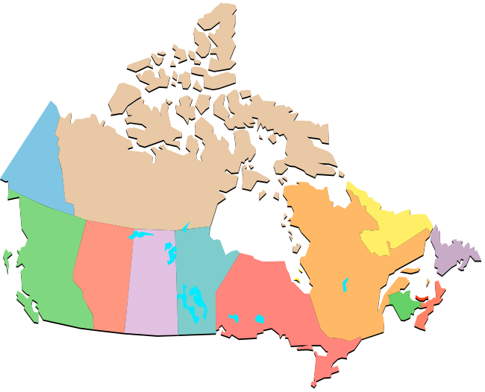


North America
FeatureCAM’s first market
Sold through a combination of direct and dealer sales
Appeals to two primary segments
  Small/medium-sized shops interested in ease of use and breadth of solution
  Larger companies interested in automation
FC continues to grow in North America

Slide 43
North American Customers
Aerospace
Allied Signal
Boeing
NASA
US Air Force
Automotive
GM
Ford
Daimler Chrysler
Hayes Brake
Medical
Baxter Healthcare
(Global)
Stryker Instrument
Miscellaneous
  Industrial Light & Magic
  Westinghouse
  1000’s of job shops

Slide 44

US Air Force
138 Air Force Bases World-wide
65 use FeatureCAM
Currently international bases prefer to work with the US for their ordering
Currently have Asian bases in Korea, Japan and Thailand

Slide 45
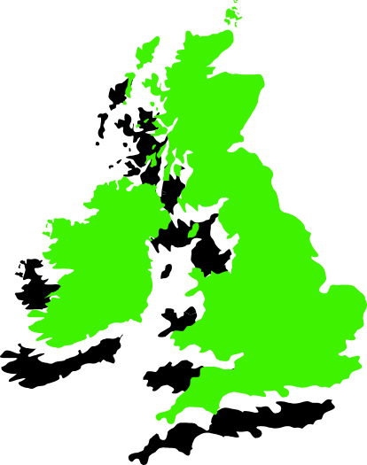

Europe
UK and Italy were FC’s first European markets
Sold for breadth of solution in UK
Production turning/milling strength in Italy
FC currently growing throughout Europe

Slide 46
European Customers
Automotive
Rover
Cosworth Racing
Aerospace
Stork Fokker AESP
RAF (8 bases)
British Aerospace
Miscellaneous
AFV (Steel)
SKF (Bearings)
Waukesha Bearing (USA as well)
Premec

Slide 47
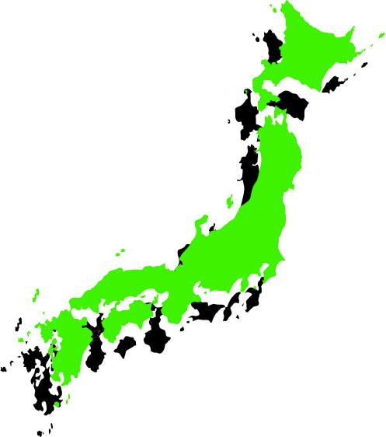


Asia
Japan was FC’s first Asian market
Extensive dealer network throughout Japan
Approximately 800 customers
Automated, feature-based approach well received
FC currently growing throughout Asia

Slide 48
Asian Customers
Automotive
Nissan (5 Divisions)
Aisin AW
Koito
Takao (Japan, Thailand, US, UK)
Honda
Consumer Products
Hitachi
National (Panasonic)
Olympus
Miscellaneous
Kobe Steel
Asahi Optical
JingWei Textile Machinery Co

Slide 49
FeatureCAM Annual Sales Conference

Slide 50
Conclusion
The FeatureCAM user interface and feature-based approach is consistent across all of the FeatureCAM products
  This approach is different from all other products
Broad family of products
Potential new sales opportunities for all

Slide 51
Conclusion
Structured and planned approach
Invest in training
Invest in marketing
Dedicated FeatureCAM sales and support
Partnerships with machine tool & CAD vendors
Get good reference customers
Strong business commitment
Good communications with FeatureCAM support

